Slide 1

Public Meeting #1 – Broad River Basin Planning
Agenda
1. Welcome and Why We Are Here – Ken Rentiers, SCDNR, Deputy Director of the Land, Water & Conservation Division
Why is water planning important to all South Carolina citizens?
Where are we in the planning process, how did we get here, and where are we going?
2. Broad River Basin Planning – Scott Harder, SCDNR, Hydrology Section Chief
What is a River Basin Plan and how will the Broad River Basin Plan be developed?
3. Next Steps for Broad River Basin Planning – Scott Harder, SCDNR
What is the schedule for planning activities in the Broad basin?
How can stakeholders apply to be on the Broad River Basin Council?
What are other ways stakeholders can be involved?
4. Comments on Edisto River Basin Planning – Hank Stallworth, Chairman of the Edisto River Basin Council (RBC)
The Edisto RBC Chairman will share his perspective on State water planning and his experience with the Edisto basin planning process.
5. Comments from the Planning Process Advisory Committee and Q&A Session – moderated by Dr. Jeff Allen, Clemson University.
PPAC Members will share their perspectives on water planning and along with SCDNR address any comments or questions about the Planning Framework and Broad basin planning activities.
Let us hear from you. We welcome your questions and feedback.
Notes:
Review Agenda, Major points:
Importance of Water Planning
How we got here – brief history of State Water Planning, five-step process
Where we are at – work of the PPAC and recent release of Planning Framework
Where we are going – application of Planning Framework in the Broad basin
Wrap up with a Q&A session

Slide 2

South Carolina State
Water Planning
Ken Rentiers
Deputy Director
S.C. Department of Natural Resources
Land, Water and Conservation Division
Broad River Basin Planning – Public Meeting #1
Columbia, SC
November 8th, 2021

Slide 3
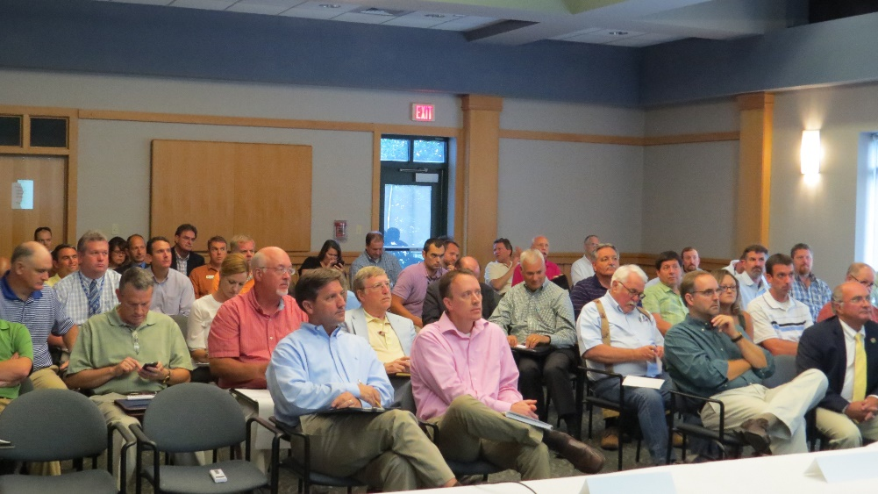
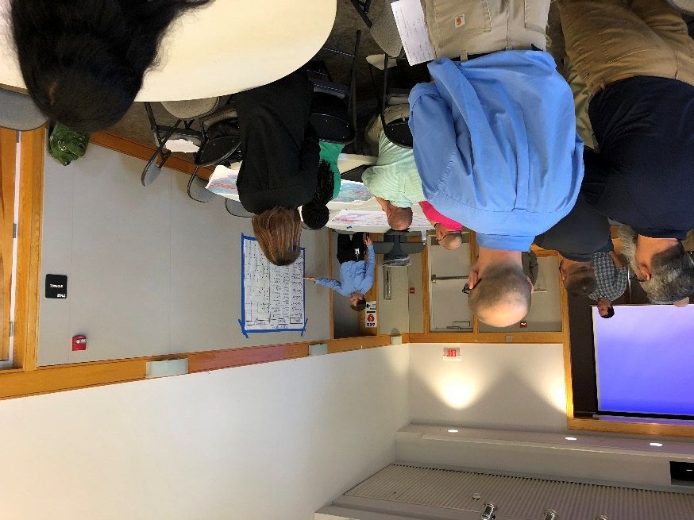
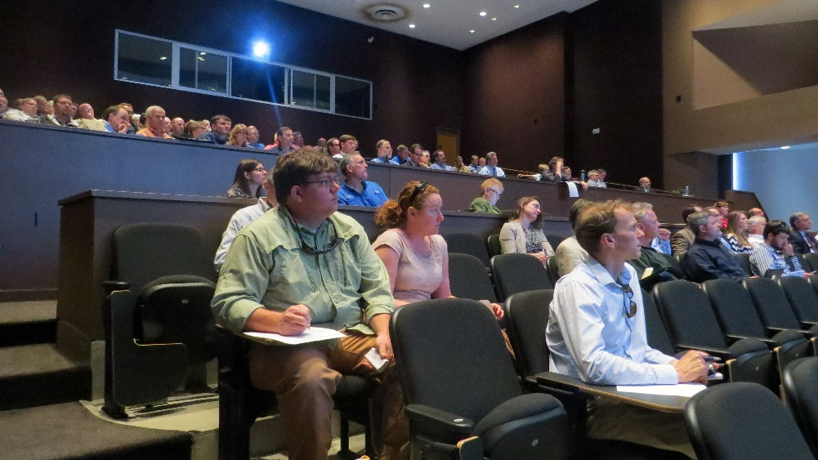
Why Are We Here?
“The effective management of South Carolina’s water resources is beyond the scope of any one agency or organization and will require cooperation and shared responsibility among federal, state, and local agencies, as well as public and private parties.”
- South Carolina Water Plan (2004)

Slide 4
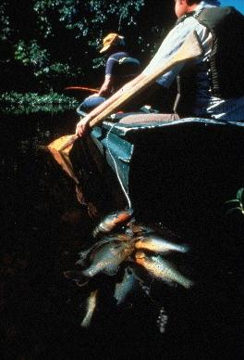
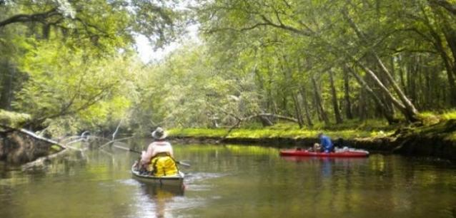
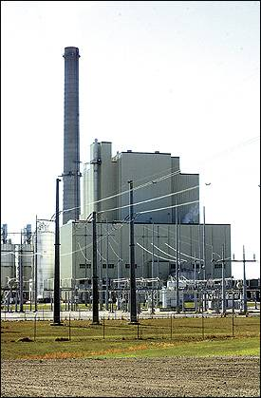
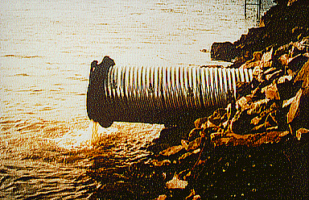

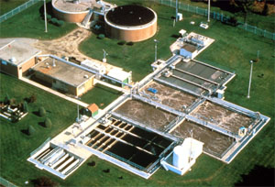
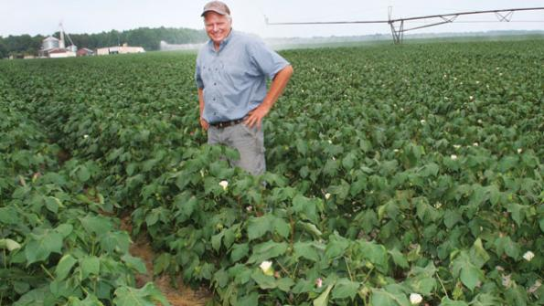
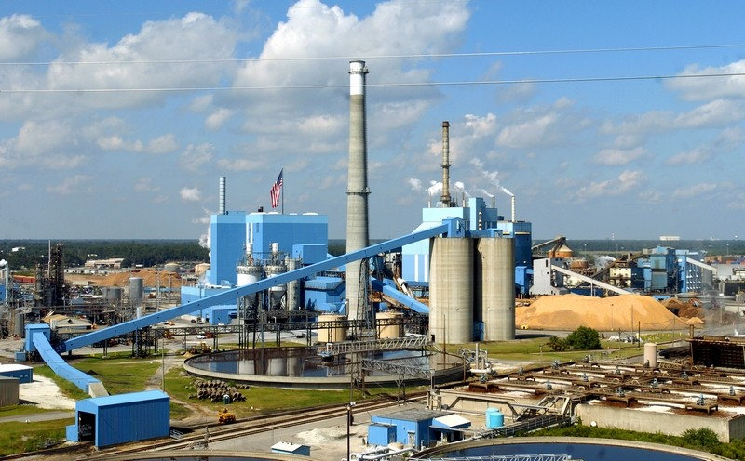

Why Are We Here?
Fishing
River Recreation
Energy
Production
Wastewater dischargers
Public Water Supply
Manufacturing/ industry
Fish and wildlife
Agriculture
Notes:
Water impacts everyone
Emphasize different uses of water, each use brings value to the State
Emphasize need for both instream and off stream uses.
Goal – ensure water will be available for all future uses
Public Health, Economic prosperity and protection of the resource.
Lead in to next slides – though SC generally has an abundance of water, there are several factors that highlight the importance of planning:

Slide 5
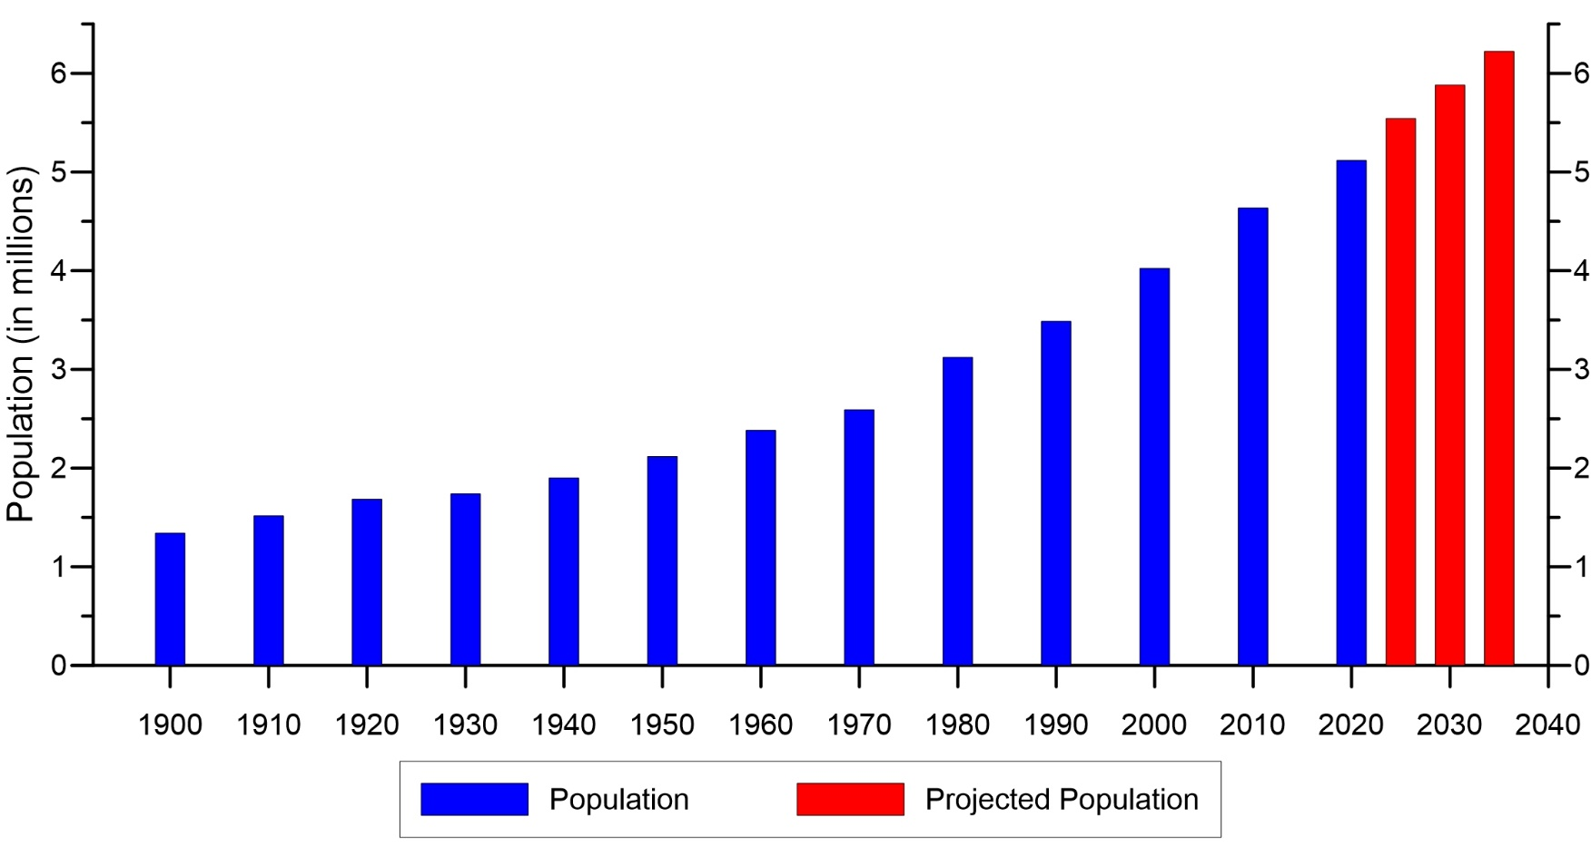
Why State Water Planning?
Population Growth → Increased Water Demand
From 1990 – 2020, SC population increased from 3.5 to 5.1 million and is forecasted to increase to 6.2 million by 2035.
Our growing population may increase future water demands and may increase competition for our water supplies.
SC Population Growth from 1900 – 2020 and Projections for 2025 – 2035
Data from the SC Office of Revenue and Fiscal Affairs, 2021, and U.S. Census Bureau, 2021.
Notes:
Bold numbers

Slide 6
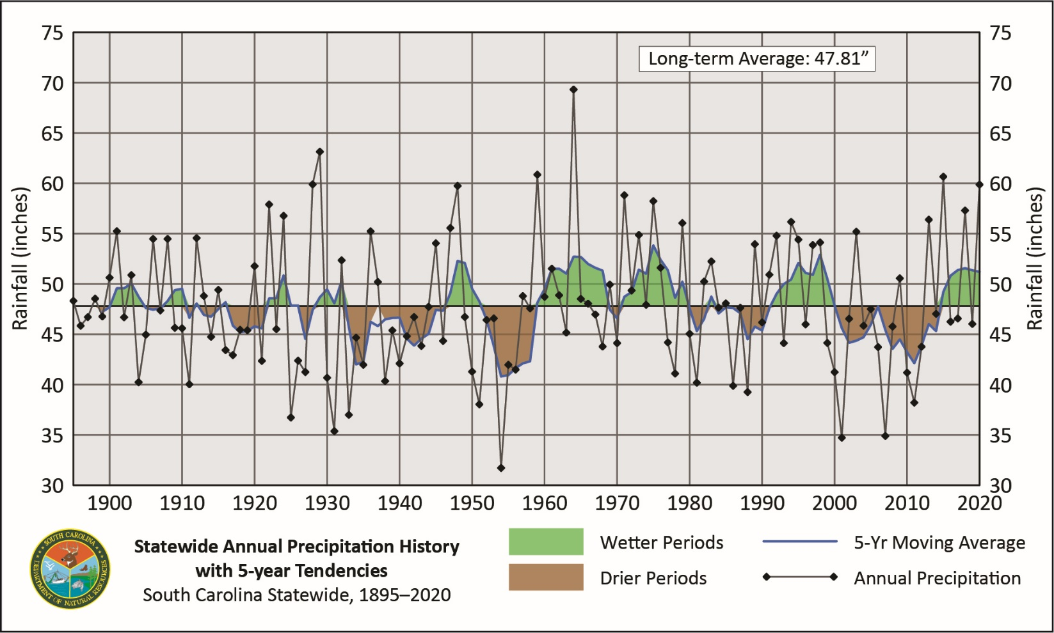
Why State Water Planning?
Drought
SC generally has an abundance of water, but recent droughts (1998-2002, 2007-2008, 2011-2012, 2016, 2019 – flash drought) have stressed the State’s water resources.
Statewide Average Annual Rainfall (inches) and 5-year Running Average
Notes:
Check with hope on exact types

Slide 7
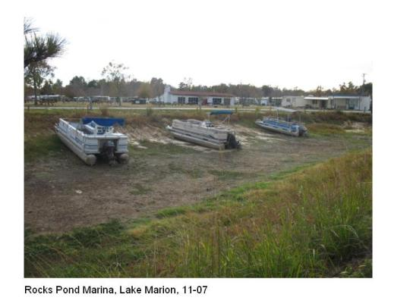
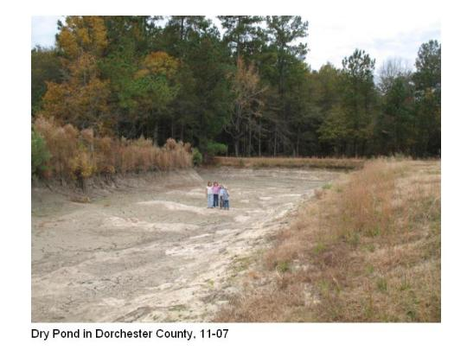
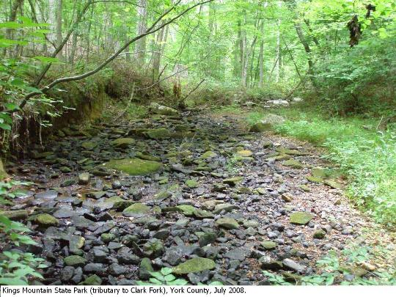
Why State Water Planning?
Tree-ring studies indicate the occurrence of more severe and longer-term droughts (Mega-droughts) over the past 400 years.
Uncertainty in the nature of future droughts combined with the potential for increasing water demands highlights the importance of comprehensive State and river basin planning.
Dorchester
County, 2007
Lake Marion, 2007
Kings Mountain
State Park, 2008
Notes:
Dry pond – Dorchester county (2007)
Streambed - Kings mountain State Park, tributary to Clarks Fork (2008)
Boats – Lake Marion (2007)

Slide 8
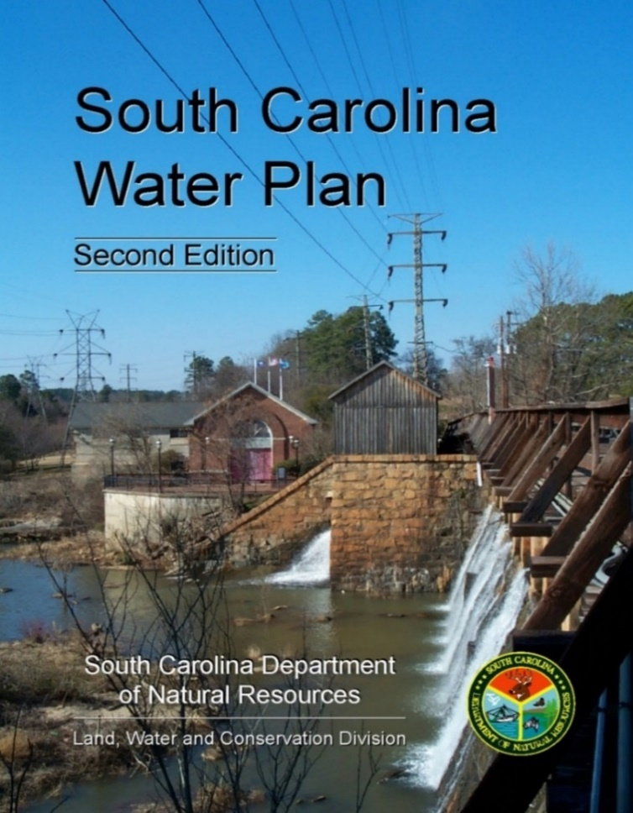
A Brief History of State Water Planning…
SCDNR published the first edition of the State Water Plan in 1998.
In 2004, SCDNR published the second edition of the South Carolina Water Plan incorporating lessons learned from the drought of 1998-2002.
One recommendation was to develop a regional water plan for each major river basin in the State.
10 years later – SCDNR and SCDHEC initiated the first step towards these regional water plans, now formally called River Basin Plans.
2004

Slide 9
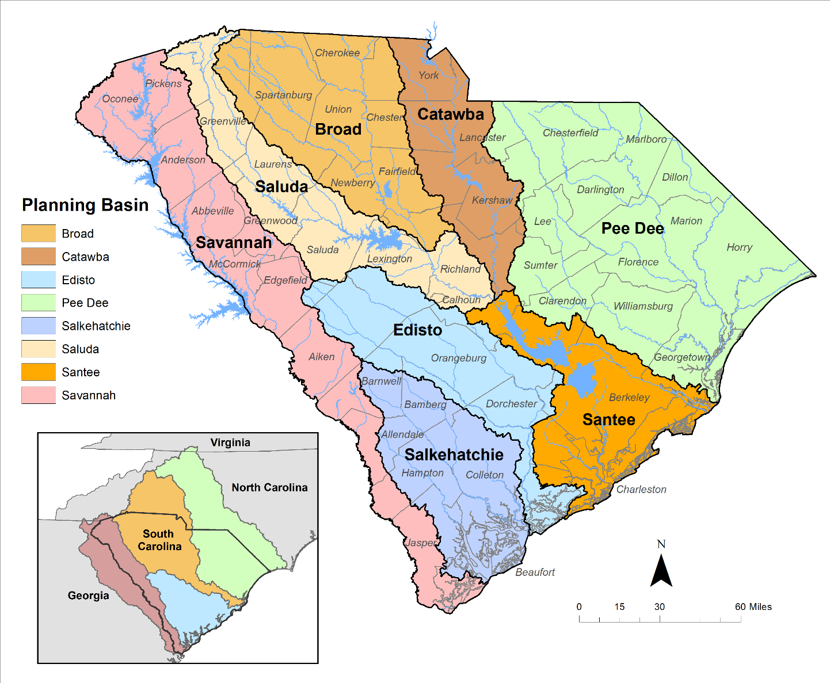
South Carolina’s Eight Planning Basins
River Basin Plans will be developed for the State’s 8 major river basins using a “bottom-up” approach where stakeholders in each basin lead the development of their basin plan.
Collectively, the River Basin Plans will form the foundation of a new State Water Plan.
Notes:
Emphasize bottom-up approach – stakeholder driven
Need for multiple perspectives on planning
Edisto is the Pilot
Why river basin plan – each basin is unique, reservoir dominated vs freely flowing, some shared with other states, differences in dominant types of water use, etc..

Slide 10
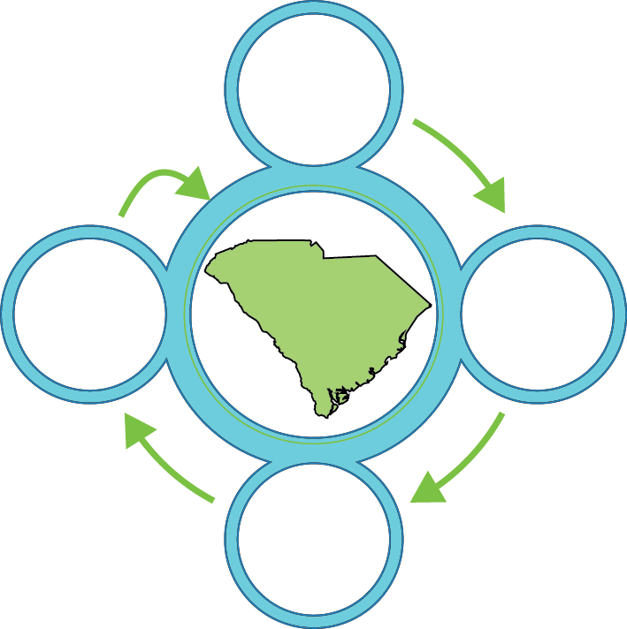






Five-step Process…
Surface Water Assessments – completed in 2017 for each basin (CDM Smith, Inc).
Several models recently updated including Broad.
Groundwater Assessment – completed in 2021 (USGS).
Water Demand Projections – methodology report completed in October 2019.
Edisto basin projections completed in 2021.
Projections for Broad basin in progress.
River Basin Plans
Publication of South Carolina State Water Planning Framework.
Edisto basin planning in progress.
Broad basin planning activities now initiated.
State Water Plan – River Basin Plans will form the foundation of a new State Water Plan.
Surface
Water Availability Assessments
1
How much water do we have?
5
River
Basin
Plans
New State Water
Plan
Groundwater Availability Assessment
4
2
How much will we need in the future?
Water Demand Projections
How do we meet future demands?
3
Cooperators:
Notes:
Emphasize collaborators
Completing the technical work/getting the science done first
Highlight recent publications (Water Demand Projection Report and planning Framework)

Slide 11
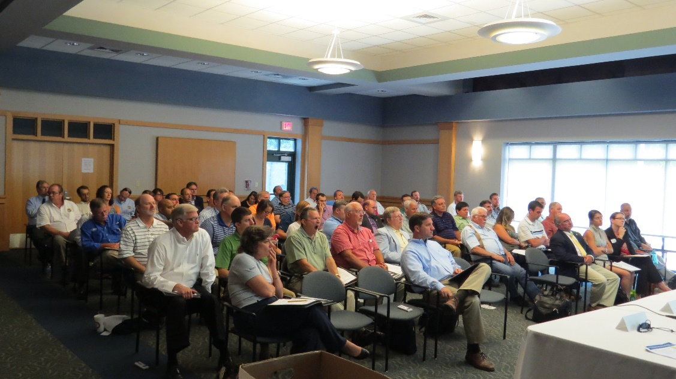
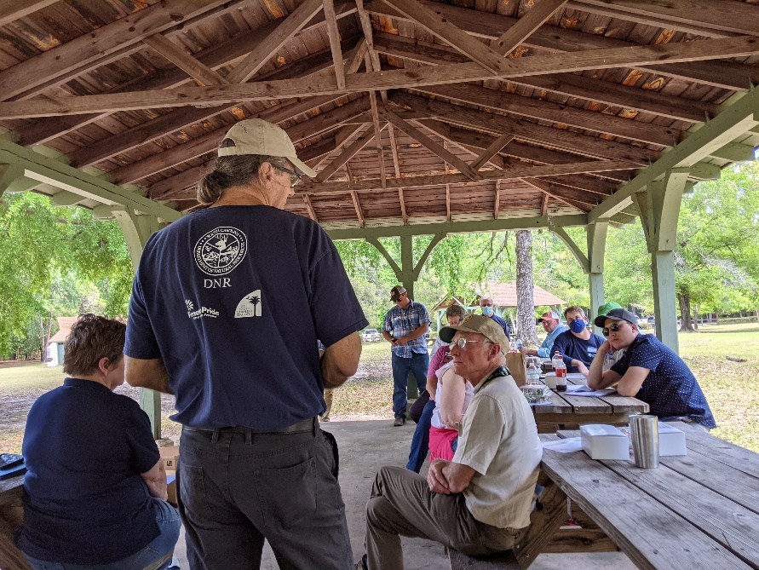
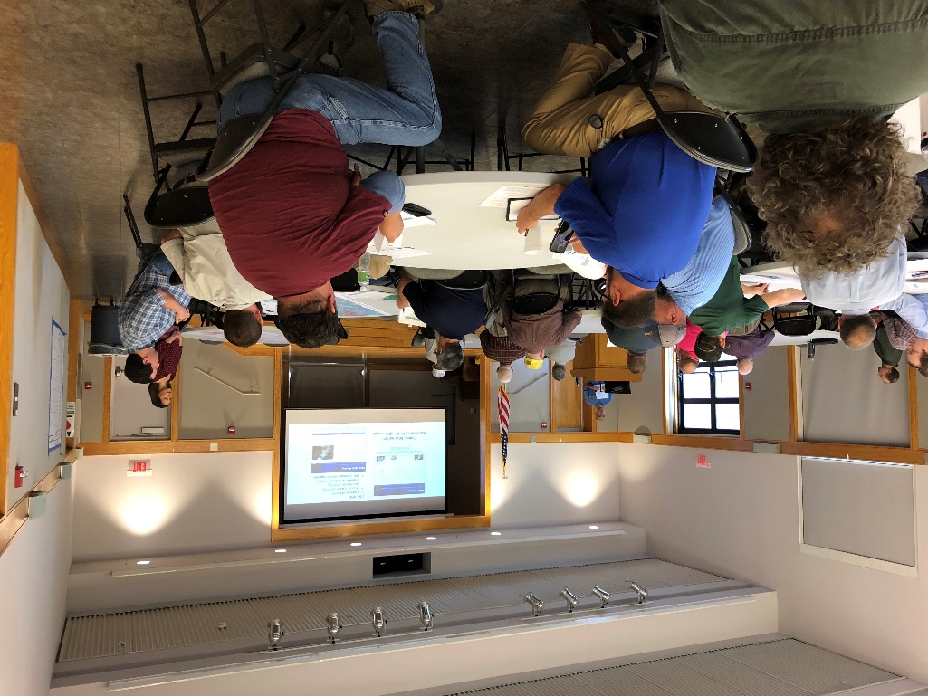
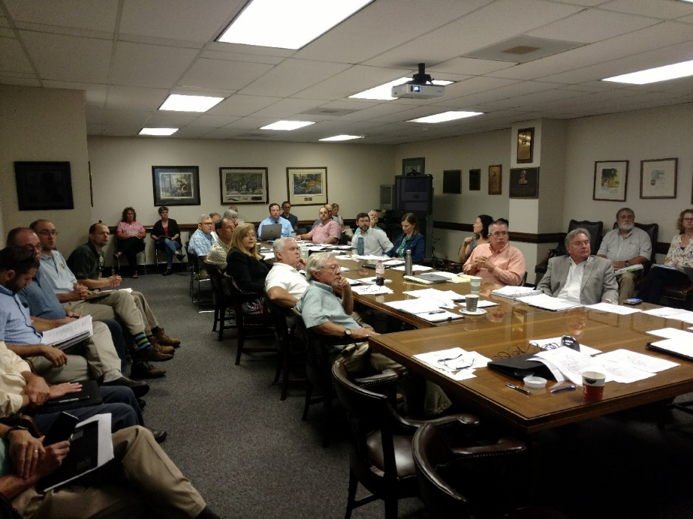
Stakeholder Participation
Broad Basin SWAM Model Stakeholder Meeting
Edisto River Basin Council Field Trip
Edisto Basin Water Demand Projection Stakeholder Meeting
PPAC Meeting
Notes:
1. SW assessments – basin stakeholder meetings and a SW TAC (also how they have stayed engaged)
2. GW assessment – coastal plain stakeholder meetings and GW TAC (also how they have stayed engaged w/ GW flow model development)
3. WD methodology development and sector specific meetings to shape and refine the WD methods and provide feedback on the draft
4. Mention briefly the PPAC and RBC processes as true stakeholder driven processes then transition to PPAC slide on slide 10

Slide 12
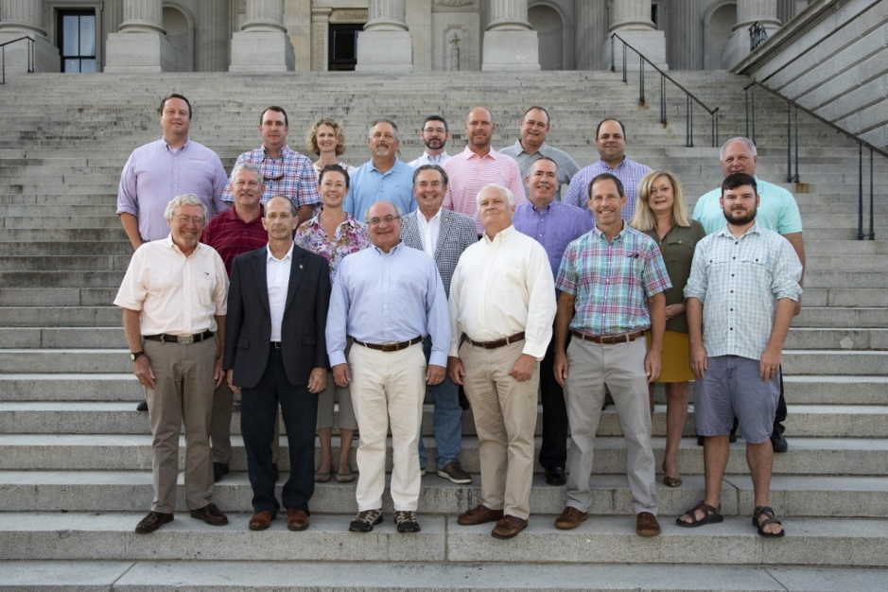
Planning Process Advisory Committee (PPAC)
Convened by SCDNR in March 2018.
Purpose - develop a guidance document (Planning Framework) for developing River Basin Plans (Step 4) and for updating the State Water Plan (Step 5).
South Carolina State Water Planning Framework (Planning Framework) was published in October 2019 after an 18-month process.
PPAC continues to meet quarterly for planning oversight purposes.
PPAC Vision Statement:
“Reflecting our values of water as a shared resource with a shared responsibility, we will work together to develop and maintain an actionable State Water Plan balancing economic, environmental and social needs of South Carolina for generations to come.”

Slide 13


PPAC Committee Members
Jeffery Allen – Clemson University
David Baize – SCAWWA/WEASC
David Bereskin – Greenville Water
Jesse Cannon – Santee Cooper
Fred Castles, III – Catawba-Wateree Water
Management Group
Clay Duffie – Mt. Pleasant Waterworks (retired)
Steve Hamilton – The Dunes Golf and Beach Club
Erika Hollis – Upstate Forever
J.J. Jowers, Jr. – Bamberg County citizen, Edisto
Engineers and Surveyors, Inc.
Eric Krueger – The Nature Conservancy
Jeff Lineberger – Duke Energy
Jill Miller – South Carolina Rural Water Association
Dean Moss, Jr. – Beaufort Jasper WSA (retired)
Myra Reece – South Carolina Department of
Health and Environmental Control
Ken Rentiers – South Carolina Department
of Natural Resources
Bill Stangler – Congaree Riverkeeper
Landrum Weathers – Farmer
Scott Willett – Anderson Regional Joint Water System
Charles Wingard – Walter P. Rawl and Sons, Inc.
For more information, visit:
https://www.clemson.edu/public/water-assessment/State_Water_Planning_Process_Advisory_Committee.html
http://hydrology.dnr.sc.gov/ppac.html
Notes:
Diverse interest group

Slide 14
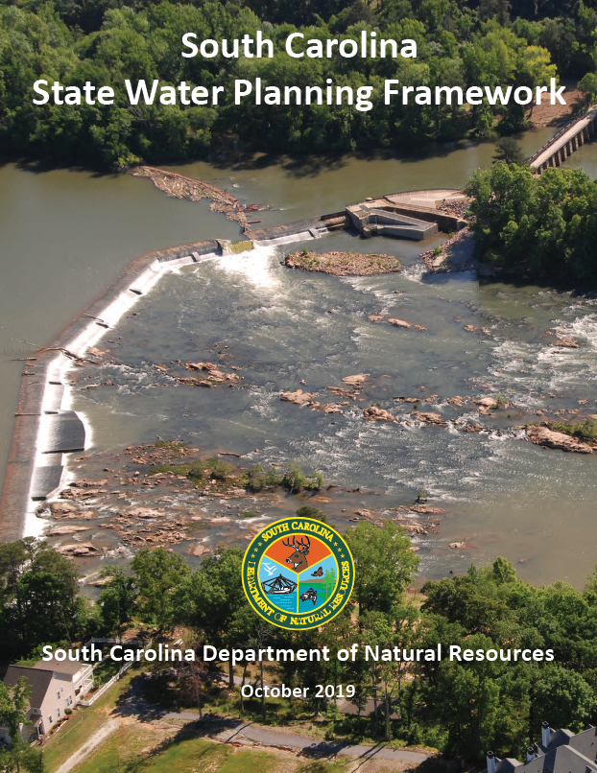
Contents of Planning Framework
Sections:
Executive Summary
Introduction
River Basin Planning Process
Methodologies for Evaluating Water Availability
River Basin Plan Table of Contents
River Basin Planning Process Implementation
River Basin Plan Implementation
State Water Plan
Appendix: River Basin Council Bylaws
Planning Framework is available for review and download at: http://hydrology.dnr.sc.gov/water-planning-framework.html.

Slide 15
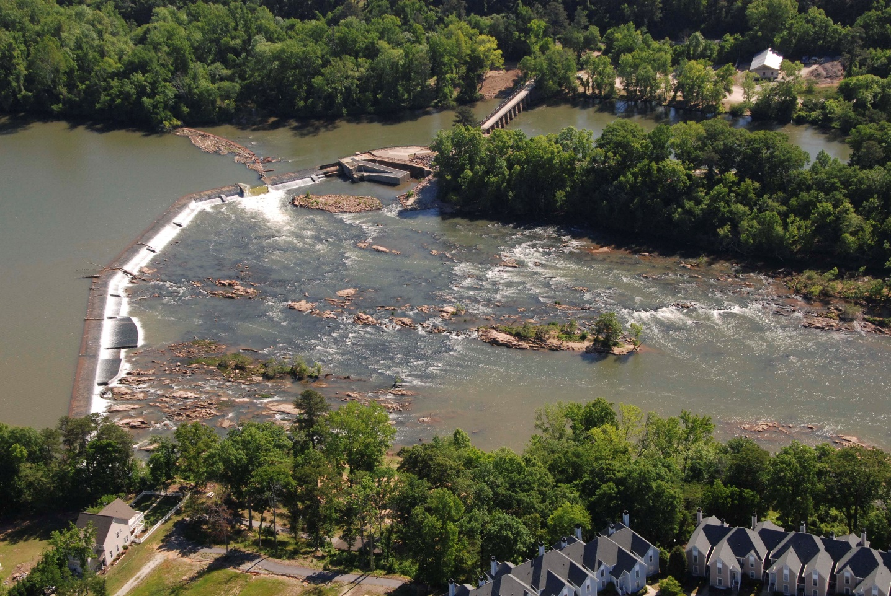
Where are we now?
Ready to start the Broad River basin
planning process under the guidance
of the Planning Framework.
Notes:
Emphasize collaborators
Completing the technical work/getting the science done first
Highlight recent publications (Water Demand Projection Report and planning Framework)

Slide 16
Public Meeting #1 – Broad River Basin Planning
1. Welcome and Why We Are Here – Ken Rentiers, SCDNR, Deputy Director of the Land, Water & Conservation Division
Why is water planning important to all South Carolina citizens?
Where are we in the planning process, how did we get here, and where are we going?
2. Broad River Basin Planning – Scott Harder, SCDNR, Hydrology Section Chief
What is a River Basin Plan and how will the Broad River Basin Plan be developed?
3. Next Steps for Broad River Basin Planning – Scott Harder, SCDNR
What is the schedule for planning activities in the Broad basin?
How can stakeholders apply to be on the Broad River Basin Council?
What are other ways stakeholders can be involved?
4. Comments on Edisto River Basin Planning – Hank Stallworth, Chairman of the Edisto River Basin Council (RBC)
The Edisto RBC Chairman will share his perspective on State water planning and his experience with the Edisto basin planning process.
5. Comments from the Planning Process Advisory Committee and Q&A Session – moderated by Dr. Jeff Allen, Clemson University.
PPAC Members will share their perspectives on water planning and along with SCDNR address any comments or questions about the Planning Framework and Broad basin planning activities.
Let us hear from you. We welcome your questions and feedback.
Notes:
Review Agenda, Major points:
Importance of Water Planning
How we got here – brief history of State Water Planning, five-step process
Where we are at – work of the PPAC and recent release of Planning Framework
Where we are going – application of Planning Framework in the Broad basin
Wrap up with a Q&A session

Slide 17
What is a River Basin Plan?

Slide 18
What is a River Basin Plan?
A River Basin Plan answers four questions:
What is the basin’s current available water supply and demand?
What are the current permitted and registered water uses?
What will be the basin’s water demand over the Planning Horizon, and will the water supply meet the demand?
What water management strategies will be employed to ensure the supply meets or exceeds the projected demand over the Planning Horizon?
Proactive Water Management, not Reactive!
Notes:
What are management strategies, simplify definition
List water management strategies.

Slide 19
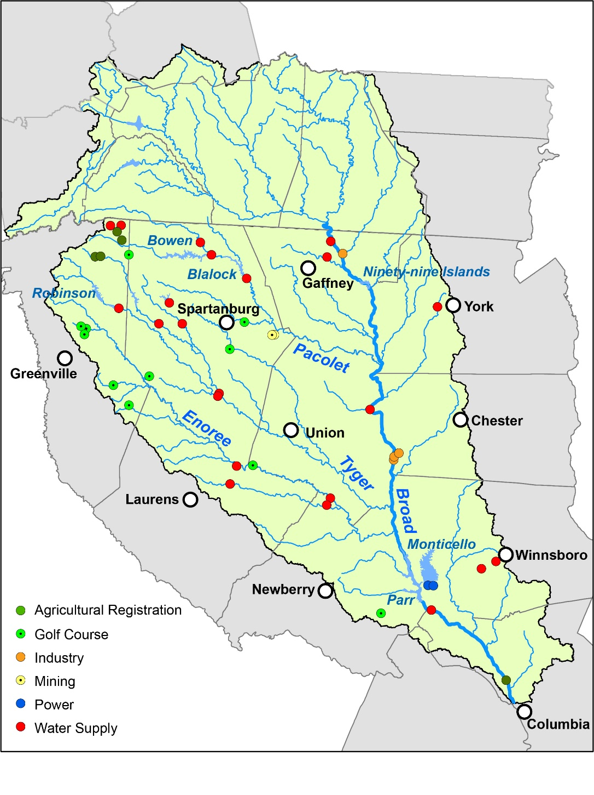
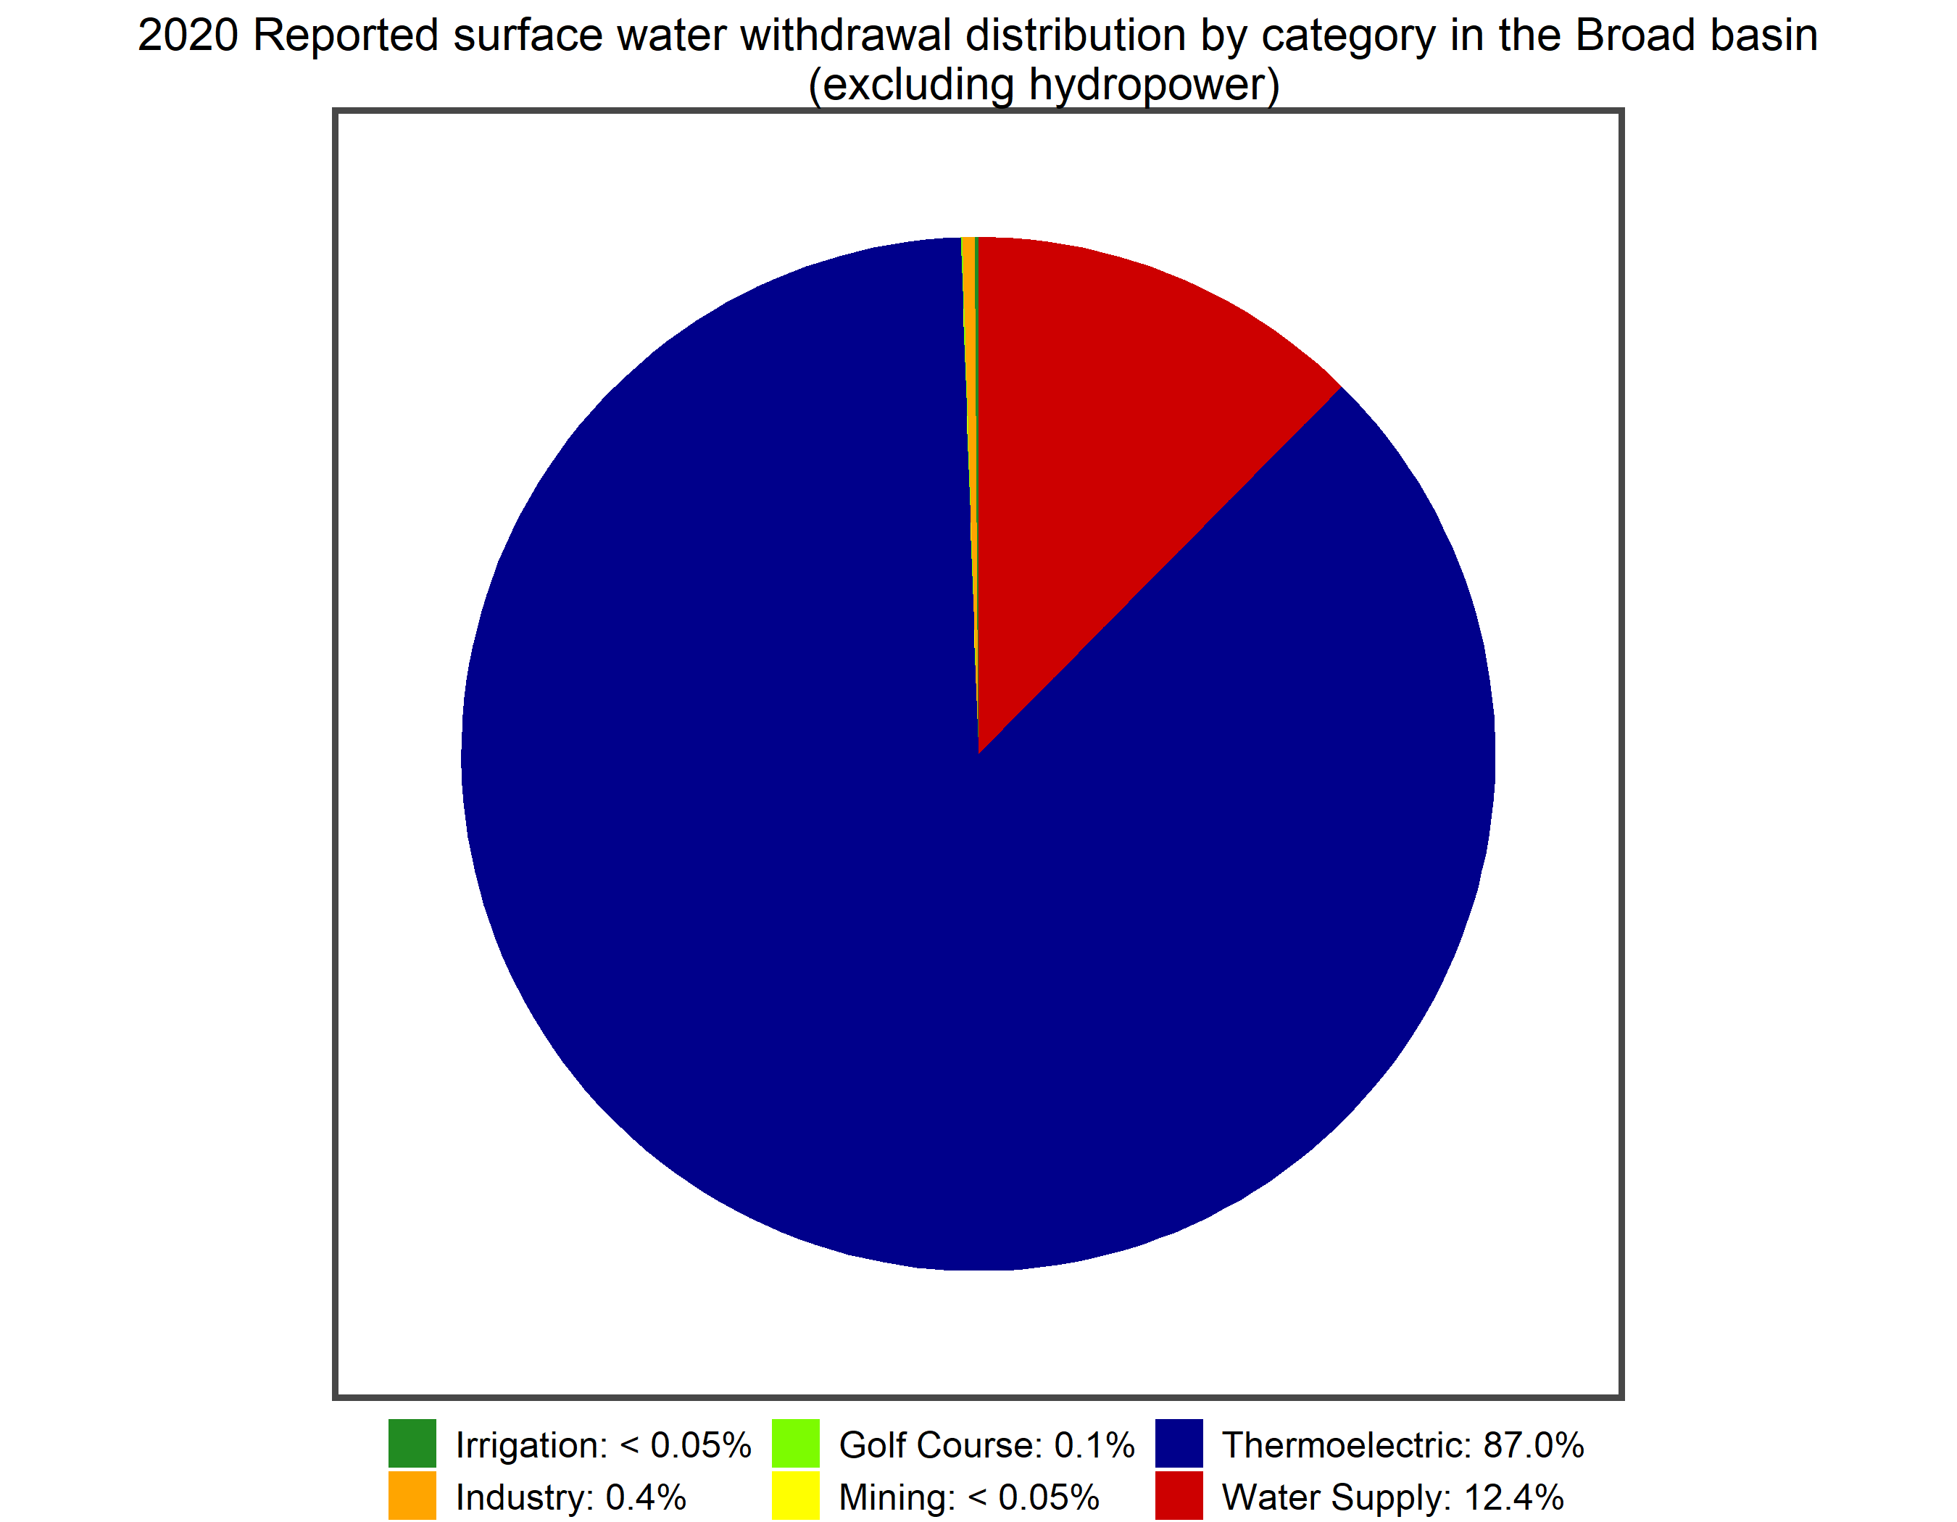


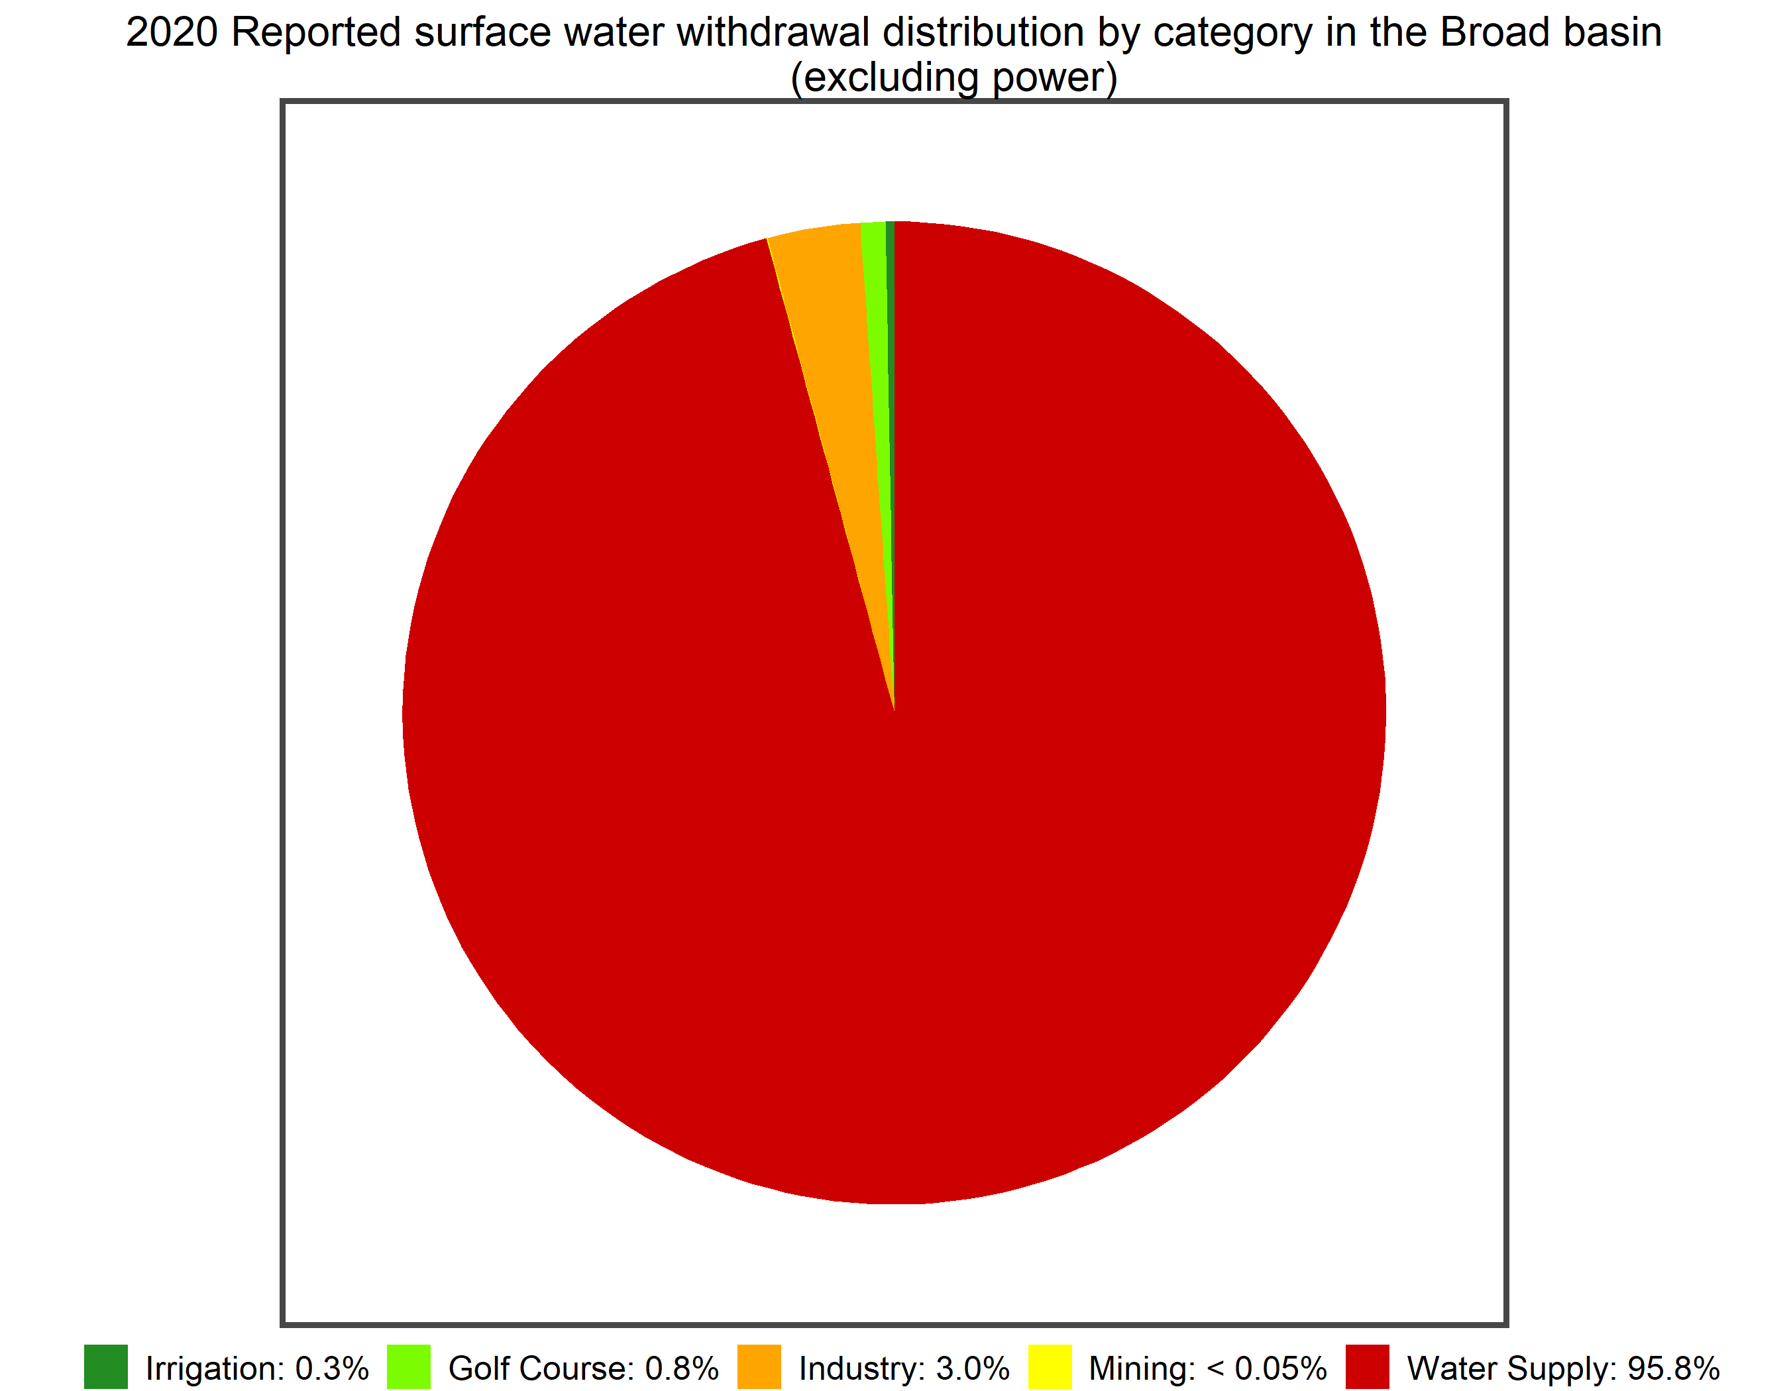
2020 Reported Surface Water Withdrawals
< 1% each:
Agricultural Irrigation,
Golf Course,
Mining,
Industry
< 1% each:
Agricultural Irrigation,
Mining
(Excluding Energy)
Notes:
GW less than 1% of total water use

Slide 20
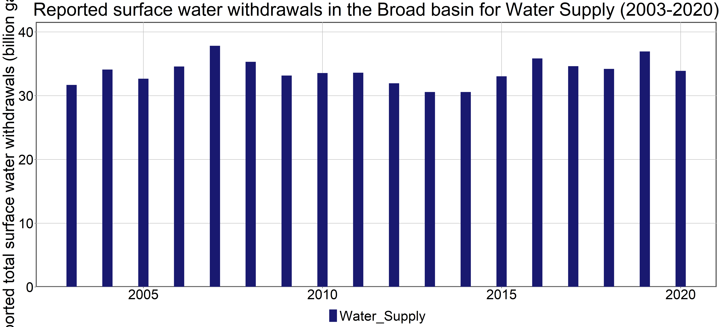
What is a River Basin Plan?
Notes:
GW less than 1% of total water use

Slide 21
Guiding Principles
Water is a limited natural resource and is a major factor for economic development and environmental protection.
River Basin Plans should strive for the equitable use of water resources with the goal of ensuring water is available for all uses, when and where needed, throughout the Planning Horizon and under drought conditions.
River Basin Plans should protect the public’s health and well-being and should balance social, economic, and environmental needs.
The effective management of South Carolina’s water resources is beyond the scope of any one agency or organization and requires cooperation and shared responsibility among federal, state, and local agencies, as well as public and private stakeholders.
Notes:
What are management strategies, simplify definition
List water management strategies.

Slide 22
River Basin Plan Table of Contents
Introduction
Description of the Basin
Water Resources of the Basin
Current and Projected Water Demand
Comparison of Water Resource Availability and Water Demand
Water Management Strategies
Water Management Strategy Recommendations
Drought Response
Policy, Legislative, Regulatory, Technical and Planning Process Recommendations
Implementation Plan
Notes:
8 and 9 important parts of the water plan

Slide 23
Features of a River Basin Plan
Covers a 50-year Planning Horizon.
Considers both surface water and groundwater resources.
Current focus is on water quantity not water quality.
Not a regulatory document but may include recommendations regarding State water policy, law and regulations.
Updated every 5-years – water planning will be an ongoing process.
Supported by hydrologic data and models along with water demand projections.

Slide 24
How Will the Broad River Basin Plan be Developed?

Slide 25
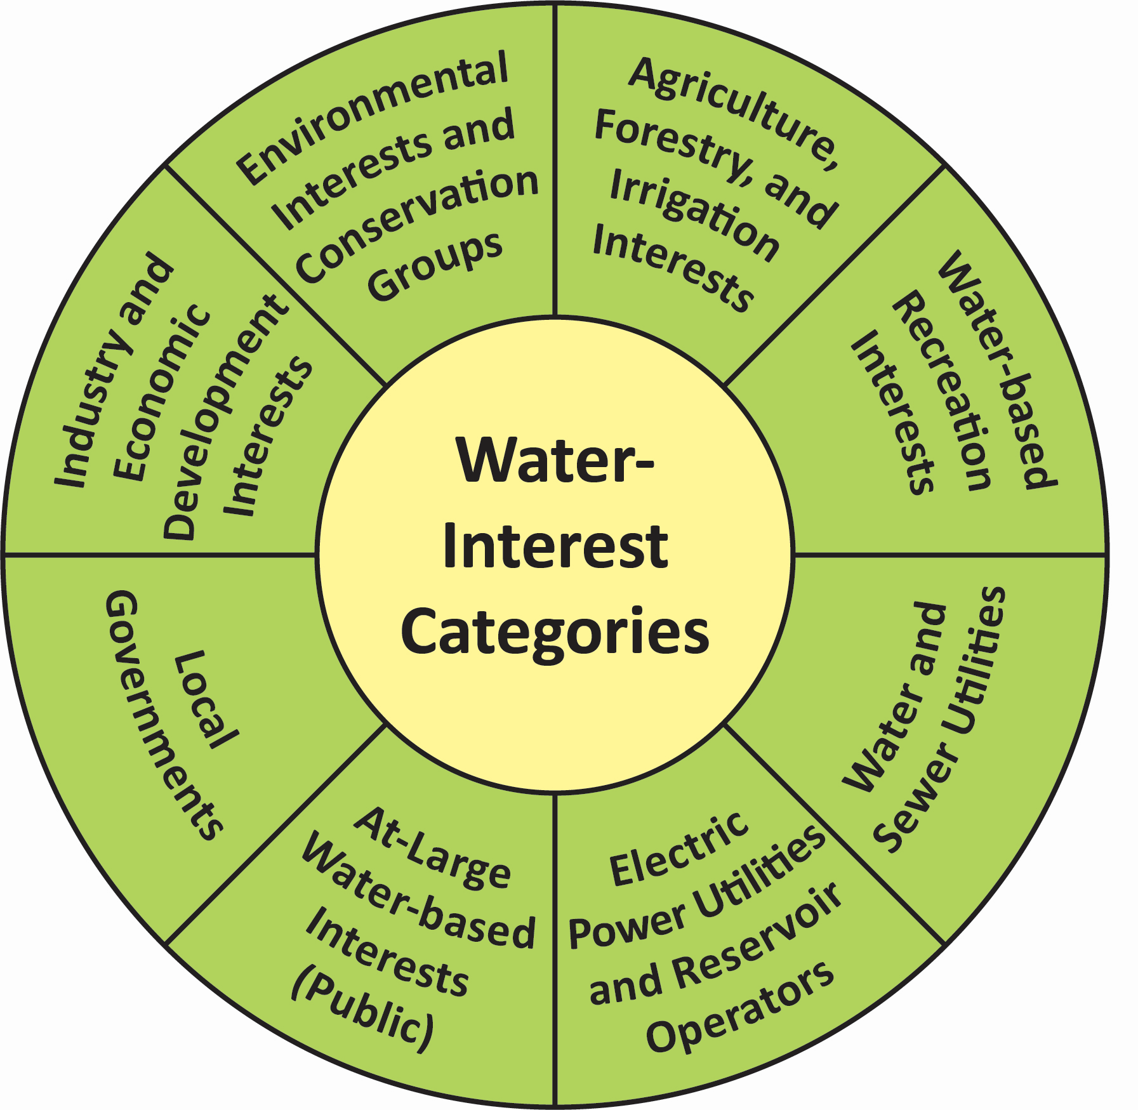
River Basin Council (RBC)
Stakeholder-led team responsible for developing the River Basin Plan.
Up to 25 members representing 8 interest categories.
Governed by a set of Bylaws.
Consensus based decision-making process.
Chair and Vice Chair elected by RBC.
RBC will develop the River Basin Plan over a 2-year period with meetings on a monthly basis
Notes:
Bylaws – Appendix of Planning Framework
After instead of through
Balanced representation

Slide 26
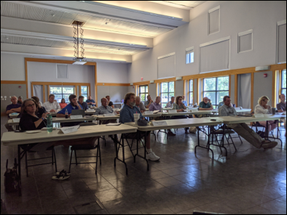
RBC Roles and Responsibilities
Identify water shortages or conflicts using hydrologic models.
Recommend strategies to mitigate or eliminate water use conflicts or water shortages.
Help draft River Basin Plans.
Communicate with stakeholders and the public on planning activities.
Coordinate with other formal planning bodies.
Recommend changes to water policy or legislation or to the water planning process.
Update River Basin Plans every 5-years and amend River Basin Plans as needed.
Edisto River Basin Council

Slide 27
Broad Surface Water Model (SWAM)
SWAM is a decision-making tool used to assess surface water availability and management strategies, and will support the development of River Basin Plans
http://hydrology.dnr.sc.gov/surface-water-models.html
Notes:
Model is available for download

Slide 28


Water Demand Projections – In Progress
Water demand methodology report released in October 2019 at http://hydrology.dnr.sc.gov/water-demand.html.
Water demand projections – stakeholder meeting to review draft projections scheduled for December 2021 – January 2022.
Projections will be used in surface water model (SWAM) to assess future water availability and will support the development of the Broad River Basin Plan.

Slide 29
RBC Support
The Broad RBC will develop the plan with support from:
Contractors (solicited and hired by SCDNR):
Meeting Facilitation
Meeting Coordination (Clemson University) – administrative and logistical support
Technical support – surface water modeling
Public Outreach (Clemson University)
River Basin Plan report writing
Other State and Federal Agencies:
RBCs can request agencies to serve as Advisors.
Participate in RBC meetings and subcommittee meetings as requested.
RBCs can request input from other outside Advisors
PPAC and SCDNR will continue to provide oversight
of the river basin planning process.
Notes:
Drought Response – evaluation and providing drought info to DRC
Communicating drought conditions to other stakeholders and public
Advocating for coordinated basin-wide drought response by entities with drought management responsibilities
Coordinating with other drought management groups.

Slide 30
Public Meeting #1 – Broad Basin Water Planning
1. Welcome and Why We Are Here – Ken Rentiers, SCDNR, Deputy Director of the Land, Water & Conservation Division
Why is water planning important to all South Carolina citizens?
Where are we in the planning process, how did we get here, and where are we going?
2. Broad River Basin Planning – Scott Harder, SCDNR, Hydrology Section Chief
What is a River Basin Plan and how will the Broad River Basin Plan be developed?
3. Next Steps for Broad River Basin Planning – Scott Harder, SCDNR
What is the schedule for planning activities in the Broad basin?
How can stakeholders apply to be on the Broad River Basin Council?
What are other ways stakeholders can be involved?
4. Comments on Edisto River Basin Planning – Hank Stallworth, Chairman of the Edisto River Basin Council (RBC)
The Edisto RBC Chairman will share his perspective on State water planning and his experience with the Edisto basin planning process.
5. Comments from the Planning Process Advisory Committee and Q&A Session – moderated by Dr. Jeff Allen, Clemson University.
PPAC Members will share their perspectives on water planning and along with SCDNR address any comments or questions about the Planning Framework and Broad basin planning activities.
Let us hear from you. We welcome your questions and feedback.
Notes:
Review Agenda, Major points:
Importance of Water Planning
How we got here – brief history of State Water Planning, five-step process
Where we are at – work of the PPAC and recent release of Planning Framework
Where we are going – application of Planning Framework in the Broad basin
Wrap up with a Q&A session

Slide 31
Broad River Basin Planning Schedule and RBC Application Process

Slide 32
Broad River Basin Planning Schedule
Nov – Dec 2021
Public kick-off meetings
Solicit RBC applications
Solicit Contractors
(in progress)
Jan 2022
Appoint RBC members
Finalize contractors
Planning Team (SCDNR, SCDHEC, Clemson, contractors) begins to meet
Feb 2022
First RBC meeting
Feb 2022 – Dec 2023
Monthly RBC meetings
Jan 2024
Completed River Basin Plan

Slide 33
RBC Membership - Qualifications and Considerations
SCDNR appointments based on the following criteria:
Applicant’s credentials
Knowledgeable and experienced in their interest category.
Must either reside, work or officially represent an entity having a significant water resource interest in the basin.
Additional qualifiers – membership on the State Drought Response Committee, for example.
Recommendations and endorsements submitted by various interest groups or organizations.
Geographic Diversity.
PPAC recommendations.
SCDNR appointments will strive
for a balanced representation
Notes:
Comment on Edisto RBC make-up and how Broad RBC make-up may be different.

Slide 34
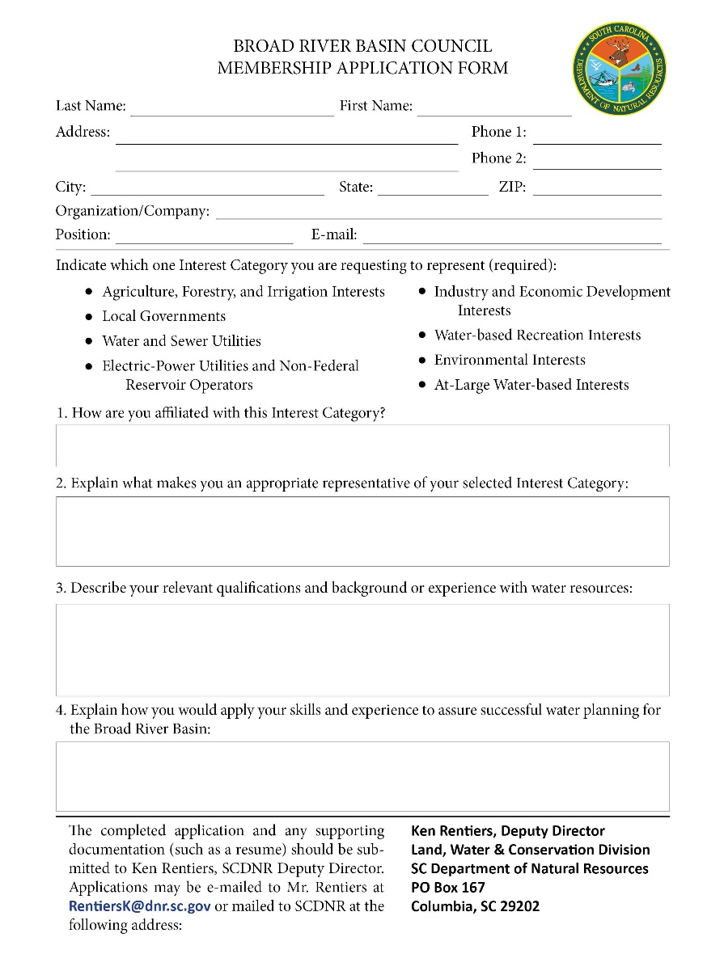
Broad River Basin Council Application Process
Applicants should carefully consider the time commitment and workload required to an RBC member
http://hydrology.dnr.sc.gov/broad-basin-planning.html

Slide 35
RBC Membership - Terms and Commitment Considerations
Initial terms are 2, 3 or 4 years.
Subsequent terms of 3 years (each additional term subject to SCDNR approval).
RBC members can serve up to 3 consecutive terms.
Considerations for RBC applicants:
Multi-year commitment.
Monthly meetings – in person!
Subcommittee meetings.
Review of various technical reports and other documents.
Help write and review River Basin Plan.
Annual meetings between iterations of River Basin Plan (possibly higher frequency).

Slide 36
Broad River Basin Council Application Process
Application period: November 8th – December 31st
Application forms available on SCDNR website:
http://hydrology.dnr.sc.gov/broad-basin-planning.html
Application forms and recommendations should be sent to Ken Rentiers (see application for contact information)
Application review period: January 2nd – January 31st
PPAC will review applications and make recommendations to SCDNR
Final selection and notification by January 31st

Slide 37
Stakeholder and Public Participation Opportunities
Guidelines for stakeholder and public participation described in Section 3.7 of Planning Framework.
Public meetings (3 to 4 per basin):
Prior to first RBC meeting – “kickoff” meeting(s)
After draft River Basin Plan is released
After final River Basin Plan is released
Draft River Basin Plan Public Review Period (30 days).
RBC Meetings:
Open to the public
Each meeting will include public comment period

Slide 38
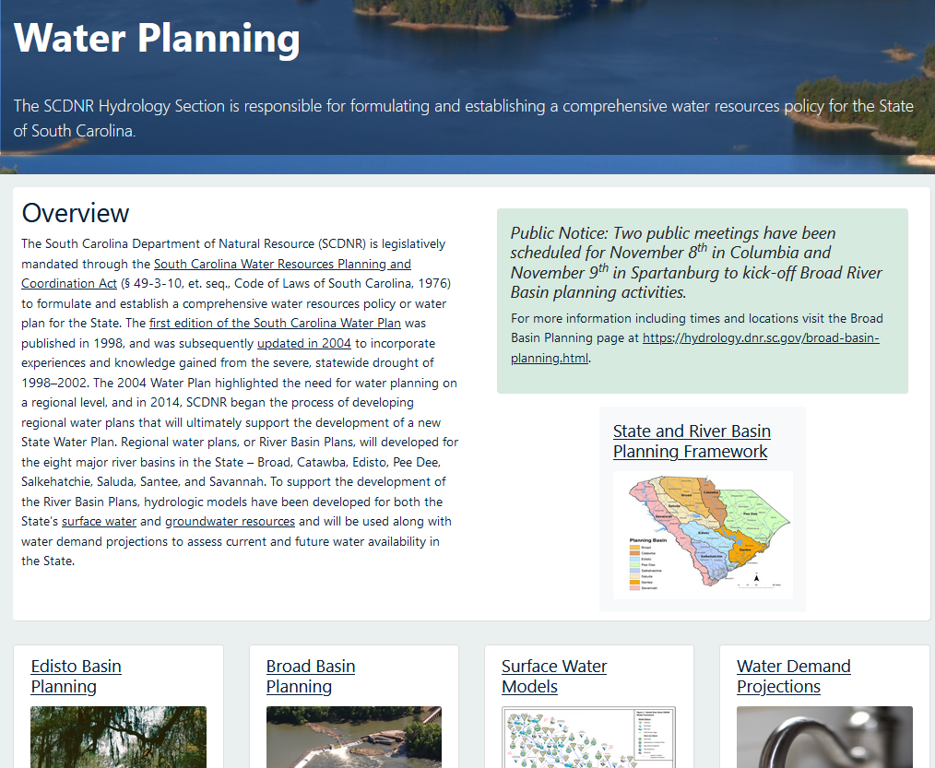
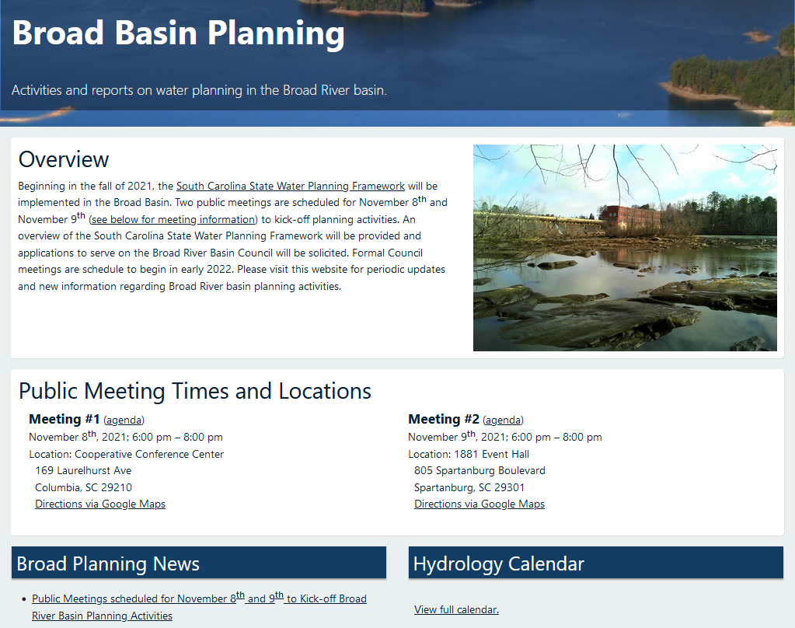
SCDNR Hydrology Section Website
Site will host:
Announcements/Calendar of Events
Access to water planning documents (Planning Framework/technical reports)
RBC meeting materials/agendas
http://hydrology.dnr.sc.gov/water-planning.html
Contact Information:
Scott Harder, harders@dnr.sc.gov
http://hydrology.dnr.sc.gov/broad-basin-planning.html

Slide 39
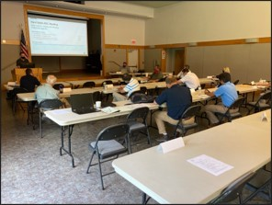
Edisto Basin Planning
First basin selected for implementing Planning Framework.
Public kick-off meetings held in November 2019.
First RBC meeting - June 2020.
Completed 16 meetings – due to Covid, first 11 meetings were held virtually, in-person meetings began in May 2021.
River Basin Plan scheduled for completion in summer 2022.

Slide 40
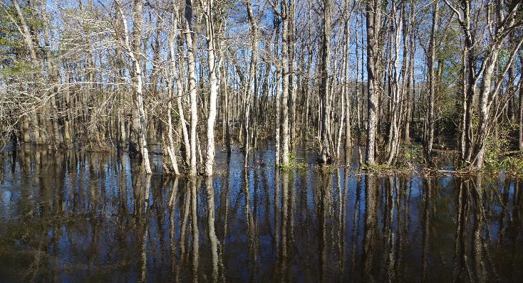
Edisto RBC Representation
Organizations Represented
Aiken County Government
Aiken Soil & Water Conservation District
Bamberg Board of Public Works
Bamberg Soil and Water District
Charleston Water System
Dominion Energy South Carolina
Dorchester County Government
Edisto River Canoe and Kayak Trail Comm.
Friends of the Edisto & Edisto Riverkeeper
Lowcountry Oyster Company, LCC
Orangeburg Country Club
Orangeburg County Government
Orangeburg Department of Public Utilities
Palmetto Realty and Land Co.
RBM Forestry LLC
General Public
The Nature Conservancy
Town of Edisto Beach
Walther Farms
Weathers Farms/ Circle W Farms
Western SC Economic Development Council
Planning Team
Interest Categories
Agriculture, Forestry, and Irrigation
At-Large
Electric-Power Utilities
Environmental
Industry and Economic Development
Local Governments
Water and Sewer Utilities
Water-based Recreational
Facilitation and
Surface Water Technical Support
Meeting Coordination and Public Outreach
Groundwater Technical Support
Oversight and Education

Slide 41
Public Meeting #1 – Broad Basin Water Planning
1. Welcome and Why We Are Here – Ken Rentiers, SCDNR, Deputy Director of the Land, Water & Conservation Division
Why is water planning important to all South Carolina citizens?
Where are we in the planning process, how did we get here, and where are we going?
2. Broad River Basin Planning – Scott Harder, SCDNR, Hydrology Section Chief
What is a River Basin Plan and how will the Broad River Basin Plan be developed?
3. Next Steps for Broad River Basin Planning – Scott Harder, SCDNR
What is the schedule for planning activities in the Broad basin?
How can stakeholders apply to be on the Broad River Basin Council?
What are other ways stakeholders can be involved?
4. Comments on Edisto River Basin Planning – Hank Stallworth, Chairman of the Edisto River Basin Council (RBC)
The Edisto RBC Chairman will share his perspective on State water planning and his experience with the Edisto basin planning process.
5. Comments from the Planning Process Advisory Committee and Q&A Session – moderated by Dr. Jeff Allen, Clemson University.
PPAC Members will share their perspectives on water planning and along with SCDNR address any comments or questions about the Planning Framework and Broad basin planning activities.
Let us hear from you. We welcome your questions and feedback.
Notes:
Review Agenda, Major points:
Importance of Water Planning
How we got here – brief history of State Water Planning, five-step process
Where we are at – work of the PPAC and recent release of Planning Framework
Where we are going – application of Planning Framework in the Broad basin
Wrap up with a Q&A session

Slide 42
Public Meeting #1 – Broad Basin Water Planning
1. Welcome and Why We Are Here – Ken Rentiers, SCDNR, Deputy Director of the Land, Water & Conservation Division
Why is water planning important to all South Carolina citizens?
Where are we in the planning process, how did we get here, and where are we going?
2. Broad River Basin Planning – Scott Harder, SCDNR, Hydrology Section Chief
What is a River Basin Plan and how will the Broad River Basin Plan be developed?
3. Next Steps for Broad River Basin Planning – Scott Harder, SCDNR
What is the schedule for planning activities in the Broad basin?
How can stakeholders apply to be on the Broad River Basin Council?
What are other ways stakeholders can be involved?
4. Comments on Edisto River Basin Planning – Hank Stallworth, Chairman of the Edisto River Basin Council (RBC)
The Edisto RBC Chairman will share his perspective on State water planning and his experience with the Edisto basin planning process.
5. Comments from the Planning Process Advisory Committee and Q&A Session – moderated by Dr. Jeff Allen, Clemson University.
PPAC Members will share their perspectives on water planning and along with SCDNR address any comments or questions about the Planning Framework and Broad basin planning activities.
Let us hear from you. We welcome your questions and feedback.
Notes:
Review Agenda, Major points:
Importance of Water Planning
How we got here – brief history of State Water Planning, five-step process
Where we are at – work of the PPAC and recent release of Planning Framework
Where we are going – application of Planning Framework in the Broad basin
Wrap up with a Q&A session

